Slide 1
Group 27
Deliverable 3
Bryan Baek, Brendan Bessel, Kalabe Mulugeta, Josiah Tillett, Xinbo Yang

Slide 2
About Aviation Port Service...

Slide 3
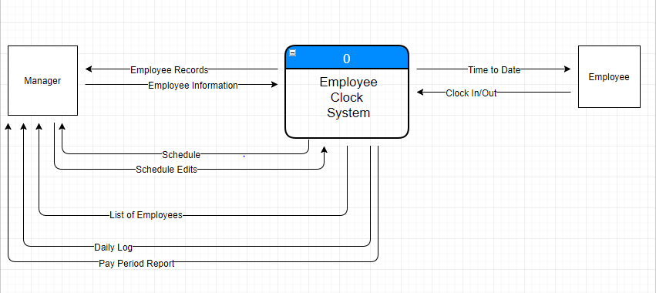
Context Level

Slide 4
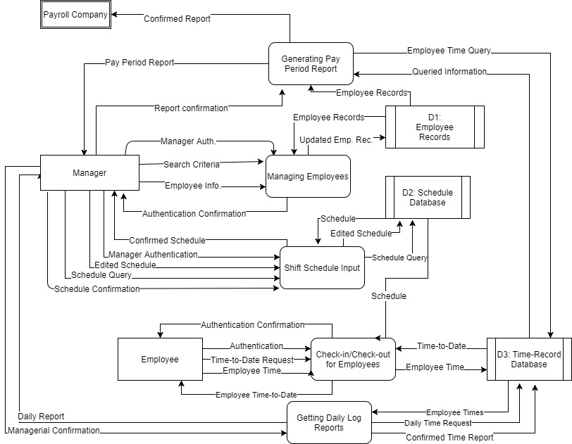
Level 0

